Slide 1
Scaling LLM Training

Slide 2
What are we scaling?
Model Size/# of Params → Increased memory consumption to fit model + gradients
# of Training Examples/# of Tokens → Training takes longer

Slide 3
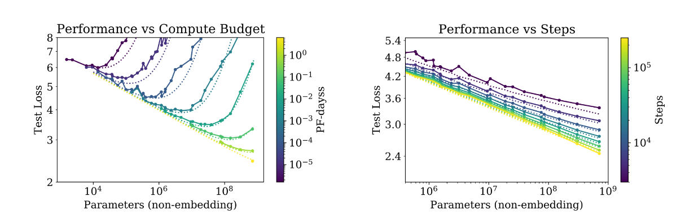
Scaling
Notes:
Figure from: https://github.com/nyu-cs2590/course-material/blob/gh-pages/fall2023/section/sec09/sec09.pdf

Slide 4
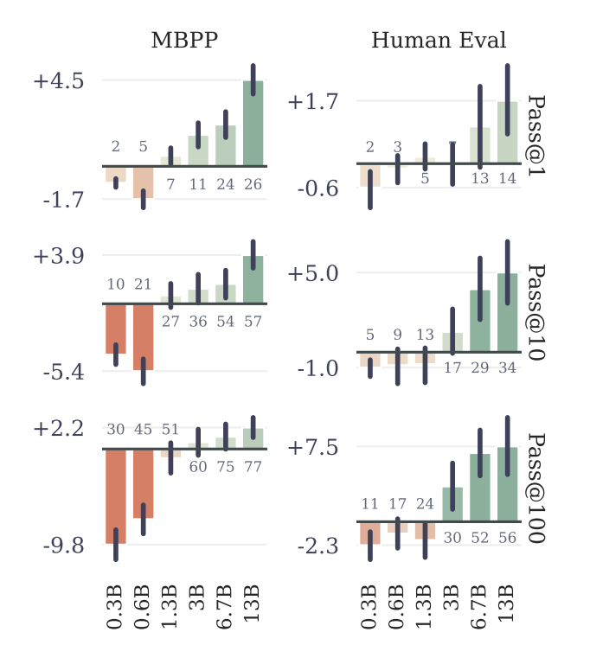
Some Ideas Need Scale
Notes:
Figure from: https://arxiv.org/abs/2404.19737

Slide 5
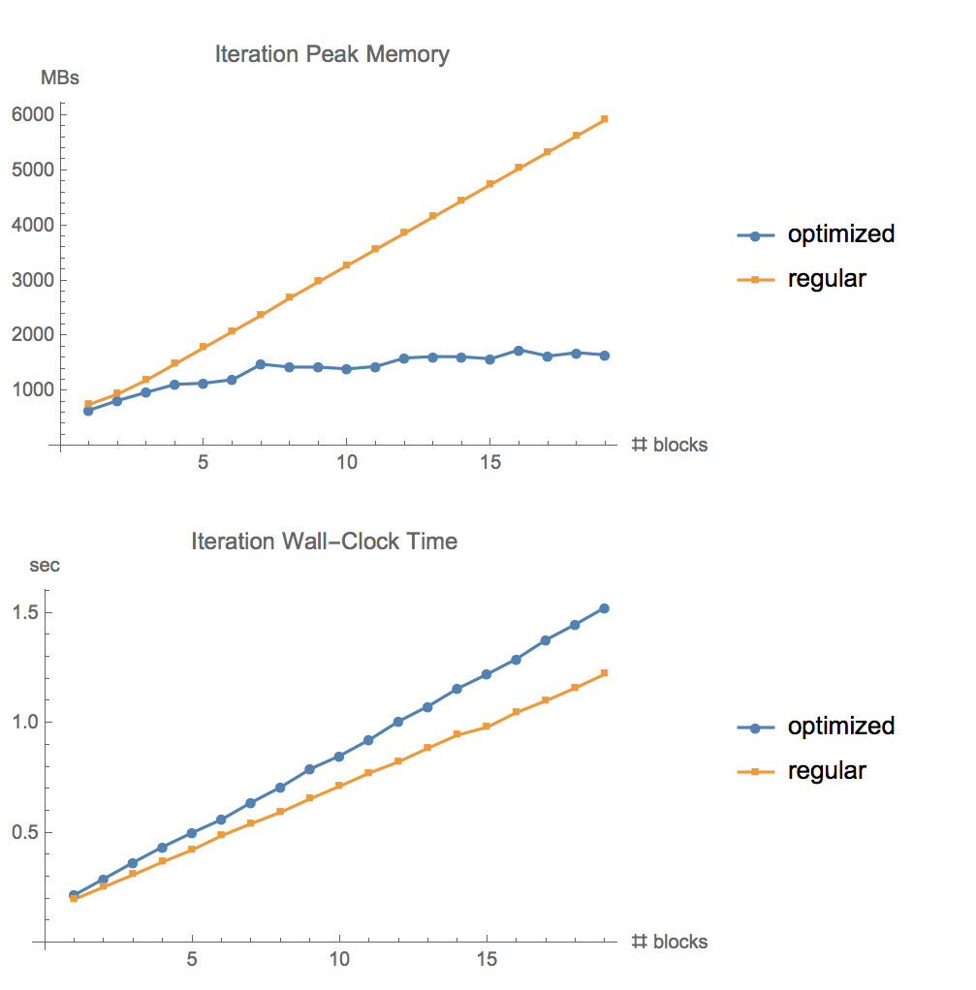
Gradient Checkpointing
Trade memory for computation by re-computing some activations during the backward pass rather than storing them
Notes:
https://github.com/cybertronai/gradient-checkpointing

Slide 6
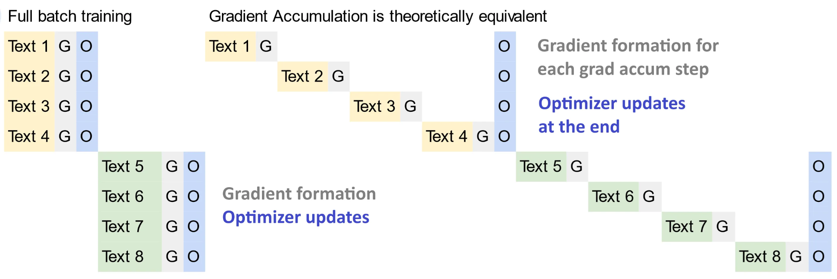
Gradient Accumulation
Notes:
https://unsloth.ai/blog/gradient

Slide 7
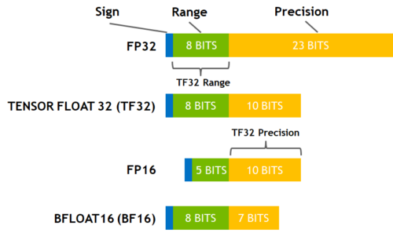
Mixed Precision Training
Notes:
Bfloat16 has three fewer bits in the significand than fp16, but three more in the exponent. And it has the same exponent size as fp32.
Consequently, converting from fp32 to bfloat16 is easy: the exponent is kept the same and the significand is rounded or truncated from 24 bits to 8; hence overflow and underflow are not possible in the conversion. On the other hand, when we convert from fp32 to the much narrower fp16 format overflow and underflow can readily happen, necessitating the development of techniques for rescaling before conversion—see the recent EPrint Squeezing a Matrix Into Half Precision, with an Application to Solving Linear Systems by me and Sri Pranesh.
The drawback of bfloat16 is its lesser precision: essentially 3 significant decimal digits versus 4 for fp16. The next table shows the unit roundoff u, smallest positive (subnormal) number xmins, smallest normalized positive number xmin, and largest finite number xmax for the three formats.
Cite: https://nhigham.com/2018/12/03/half-precision-arithmetic-fp16-versus-bfloat16/
https://developer.nvidia.com/blog/accelerating-ai-training-with-tf32-tensor-cores/
Figure: https://huggingface.co/docs/transformers/v4.15.0/en/performance

Slide 8
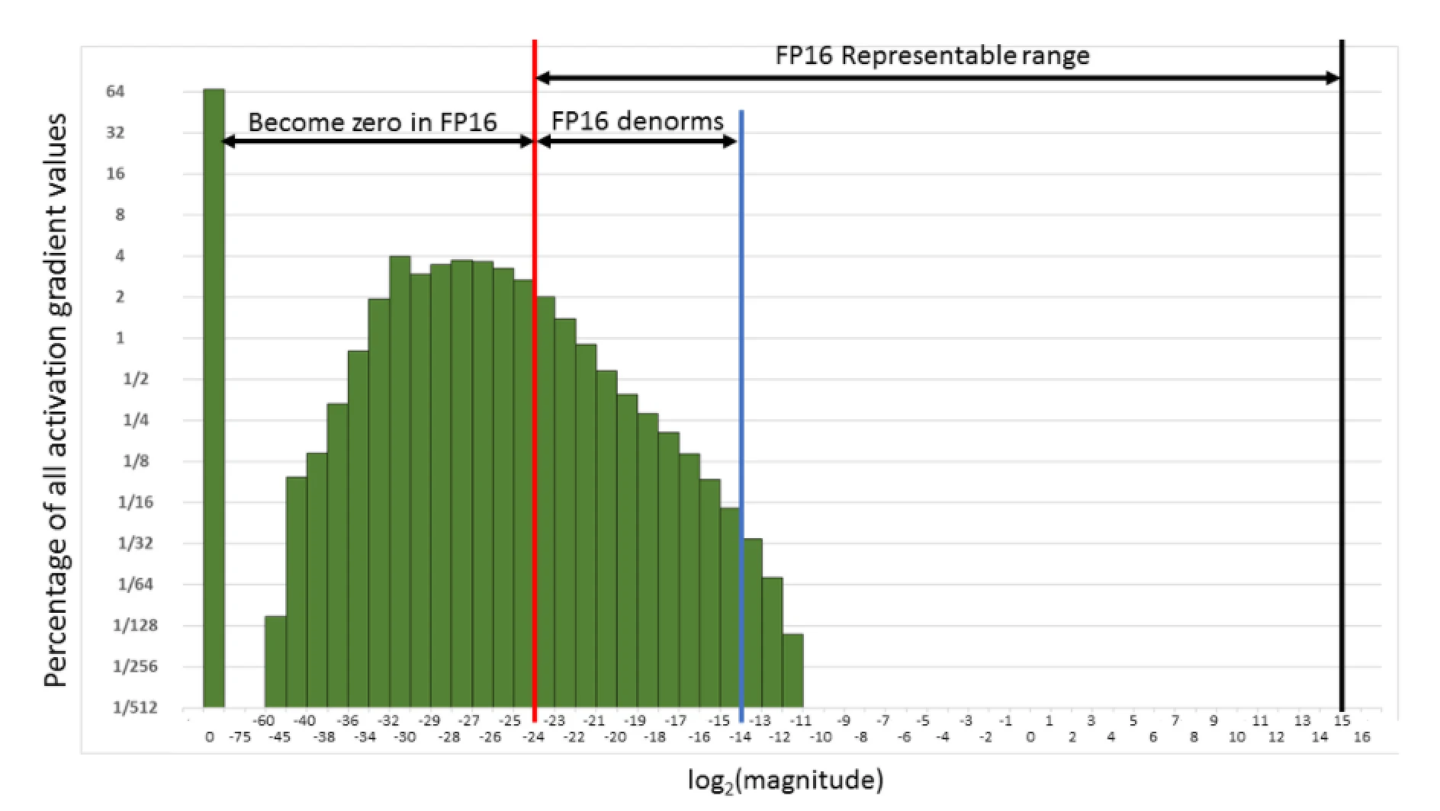
Mixed Precision Training – Loss Scaling
Small gradient values will → 0 in half precision
To solve, scale the gradients to keep them from becoming 0
Weight gradients need to be unscaled again prior to update, and some values need to be kept in full precision (e.g. batch norm statistics & softmax)
Notes:
As was shown in the previous section, successfully training some networks requires gradient value scaling to keep them from becoming zeros in FP16. This can be achieved with a single multiplication. You can scale the loss values computed in the forward pass, before starting backpropagation. By the chain rule, backpropagation ensures that all the gradient values of the same amount are scaled. This requires no extra operations during backpropagation and keeps the relevant gradient values from becoming zeros and losing that gradient information.
Weight gradients must be unscaled before weight update, to maintain the magnitude of updates the same as in FP32 training. It is simplest to perform this descaling right after the backward pass but before gradient clipping or any other gradient-related computations. This ensures that no hyperparameters (such as gradient clipping threshold, weight decay, etc.) have to be adjusted.
While many networks match FP32 training results when all tensors are stored in FP16, some require updating an FP32 copy of weights. Furthermore, values computed by large reductions should be left in FP32. Examples of this include statistics (mean and variance) computed by batch-normalization, SoftMax. Batch-normalization can still take FP16 inputs and outputs, saving half the bandwidth compared to FP32, it’s just that the statistics and value adjustment should be done in FP32. This leads to the following high-level procedure for training:
Maintain a primary copy of weights in FP32.
For each iteration:
Make an FP16 copy of the weights.
Forward propagation (FP16 weights and activations).
Multiply the resulting loss with the scaling factor S.
Backward propagation (FP16 weights, activations, and their gradients).
Multiply the weight gradient with 1/S.
Complete the weight update (including gradient clipping, etc.).
Text + Figure: https://docs.nvidia.com/deeplearning/performance/mixed-precision-training/index.html

Slide 9
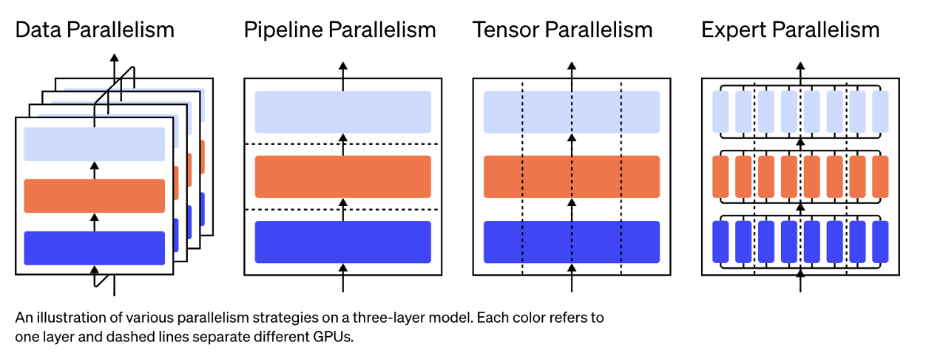
Parallelism
Notes:
Figure from: https://github.com/nyu-cs2590/course-material/blob/gh-pages/fall2023/section/sec09/sec09.pdf

Slide 10
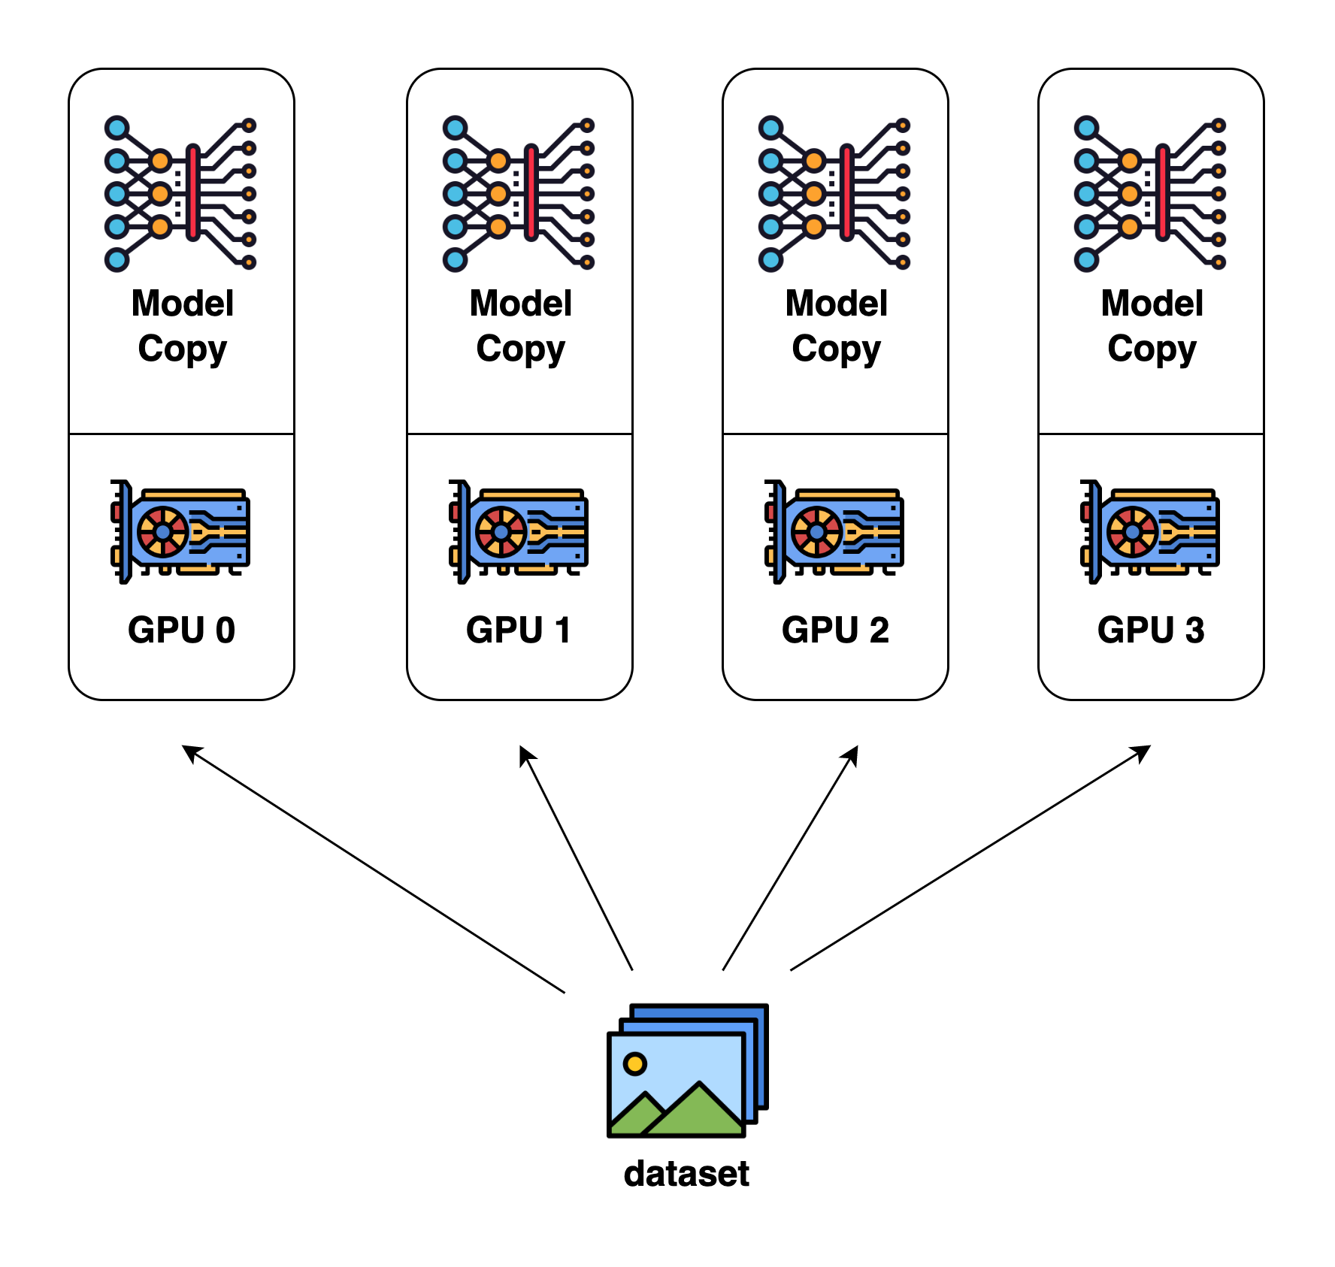
Data Parallelism
Notes:
https://colossalai.org/docs/concepts/paradigms_of_parallelism/

Slide 11
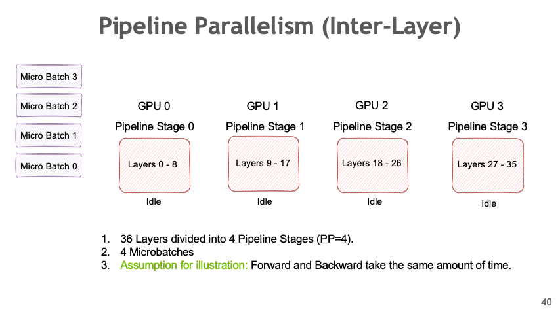
Pipeline Parallelism
Notes:
https://docs.nvidia.com/nemo-framework/user-guide/latest/nemotoolkit/features/parallelisms.html

Slide 12
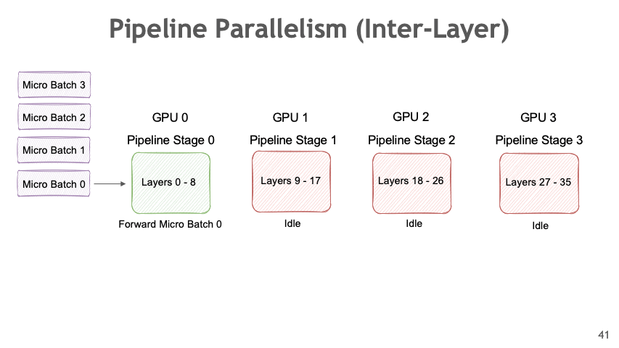
Pipeline Parallelism

Slide 13
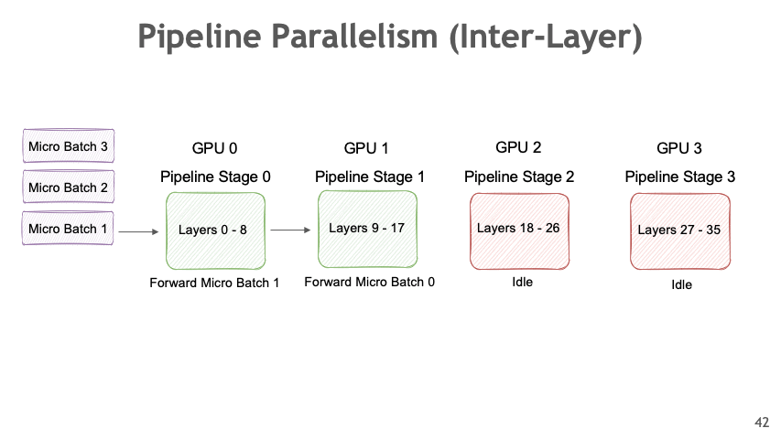
Pipeline Parallelism

Slide 14
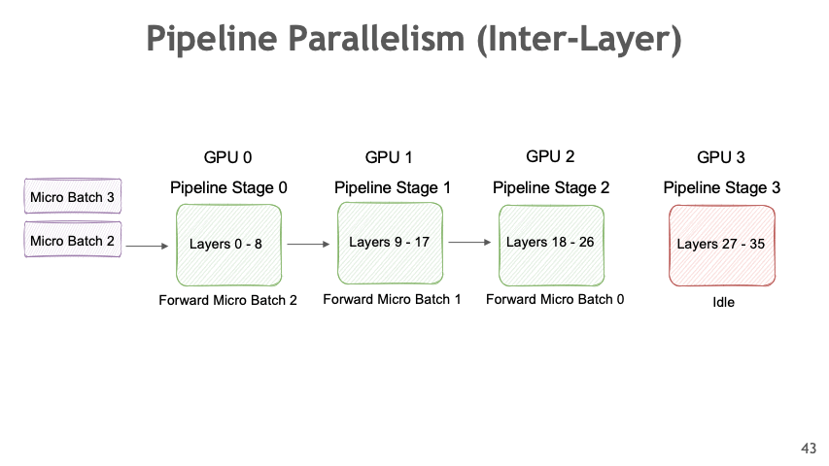
Pipeline Parallelism

Slide 15
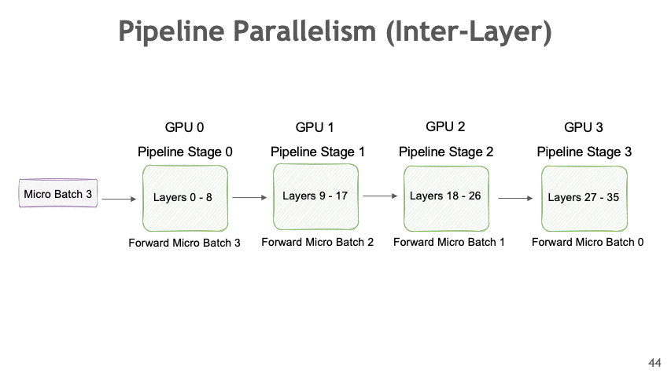
Pipeline Parallelism

Slide 16
Pipeline Parallelism

Slide 17
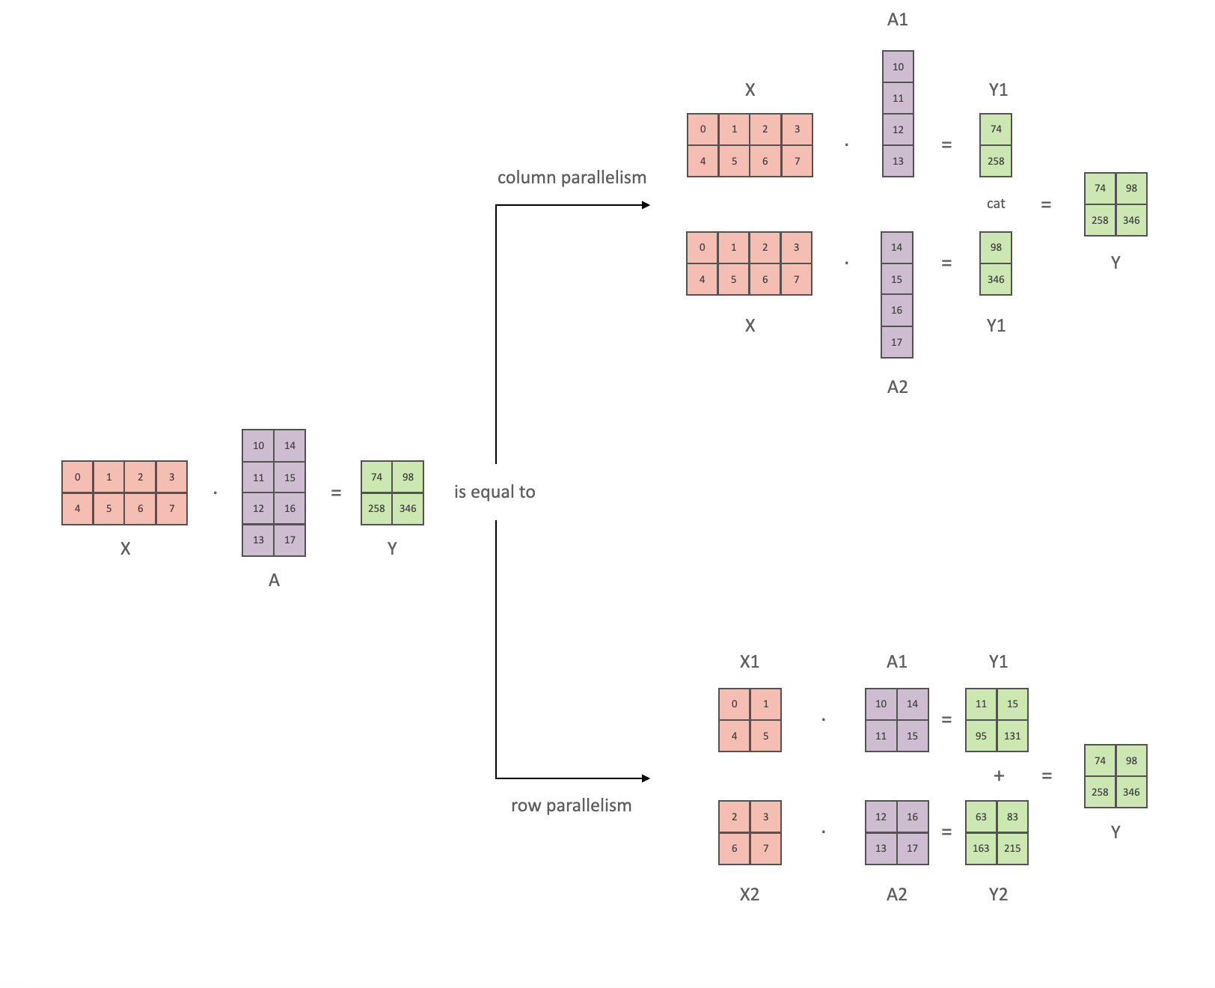
Tensor Parallelism
Notes:
https://docs.nvidia.com/nemo-framework/user-guide/latest/nemotoolkit/features/parallelisms.html

Slide 18
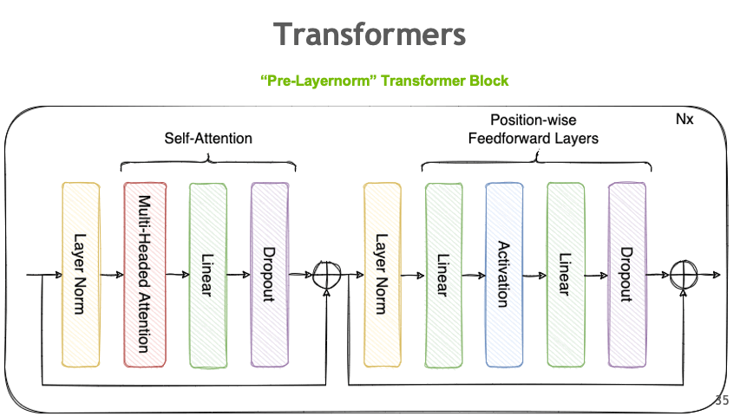
Tensor Parallelism

Slide 19
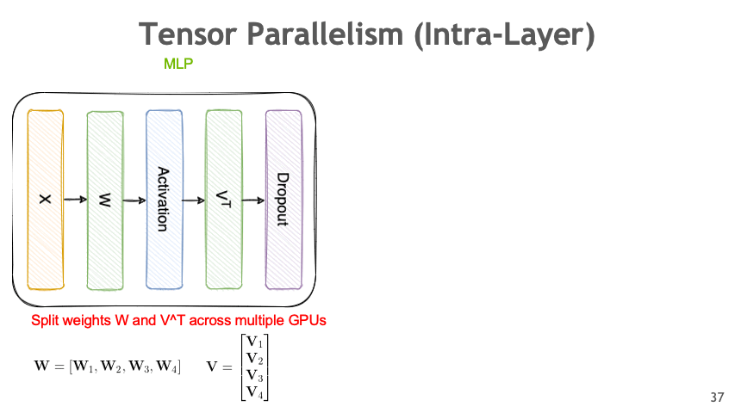
Tensor Parallelism

Slide 20
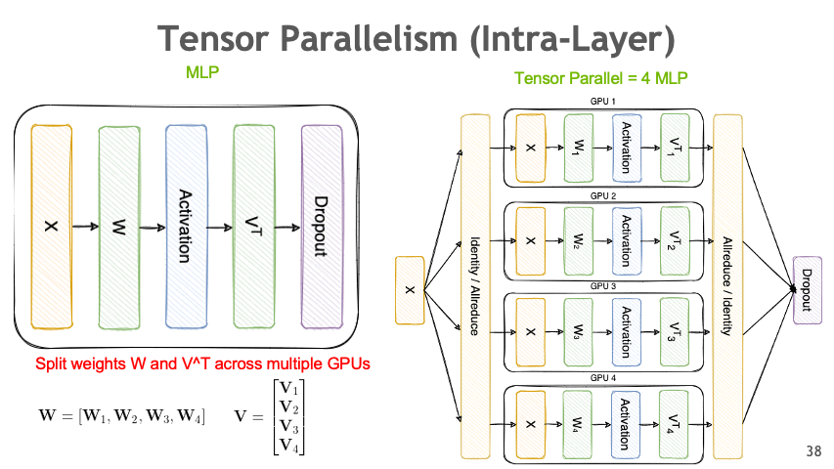
Tensor Parallelism

Slide 21
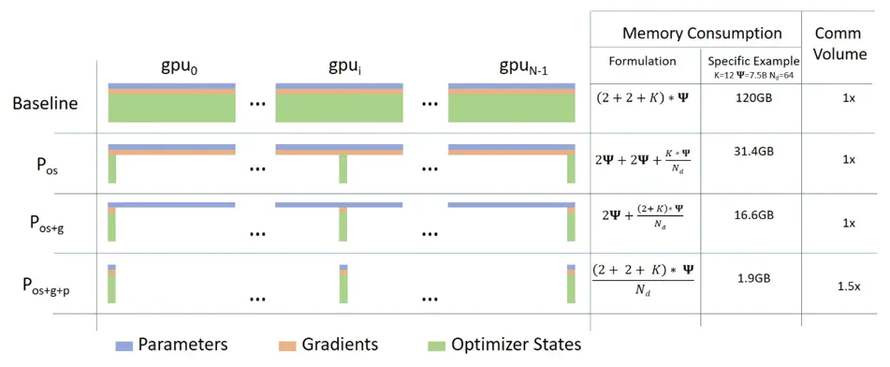
ZeRO
Notes:
https://www.microsoft.com/en-us/research/blog/zero-deepspeed-new-system-optimizations-enable-training-models-with-over-100-billion-parameters/

Slide 22
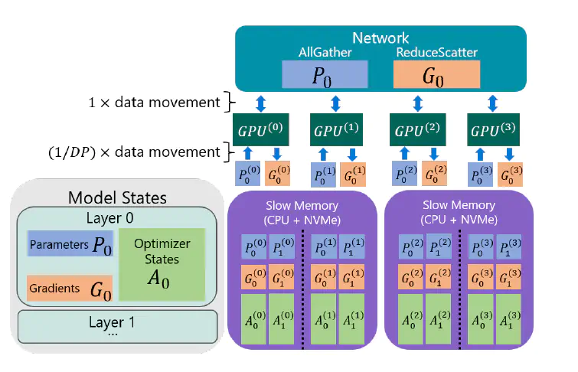
CPU-Offloading
Notes:
https://sumanthrh.com/post/distributed-and-efficient-finetuning/

Slide 23
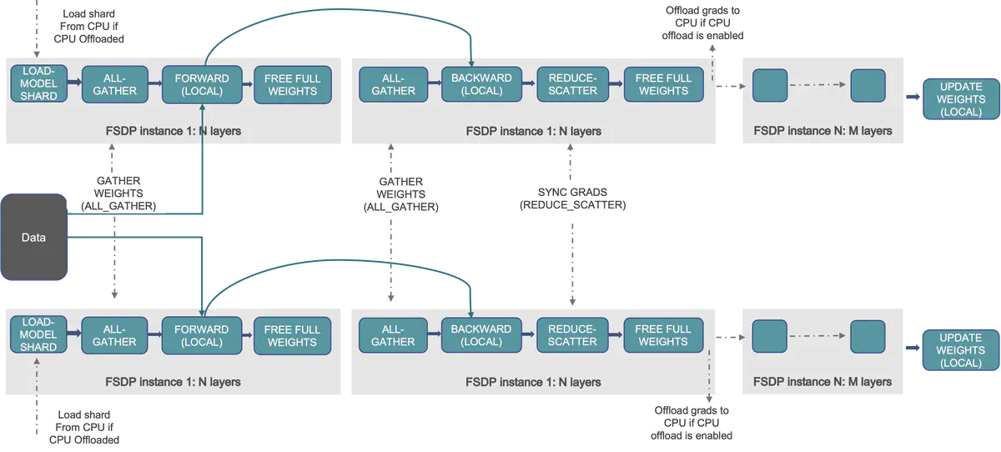
Fully Sharded Data Parallel
Notes:
https://sumanthrh.com/post/distributed-and-efficient-finetuning/

Slide 24
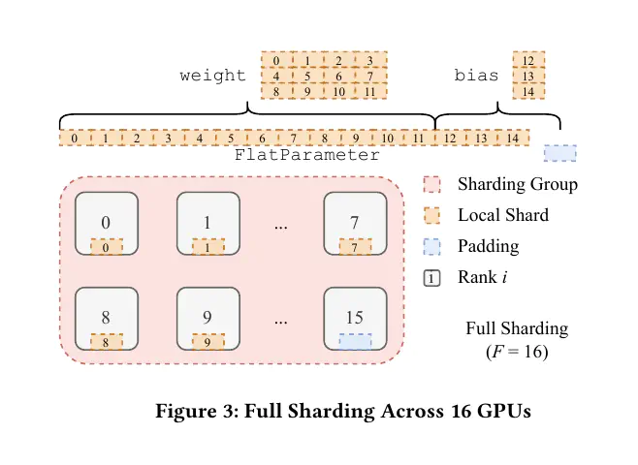
Fully Sharded Data Parallel
Notes:
https://sumanthrh.com/post/distributed-and-efficient-finetuning/

